Slide 1

RetailIQ – Full-Cycle E-Commerce Customer & Sales Analytics
DATA SCIENCE (24AD3107) Project Review-1
17/9/2026
 | Under the Guidance of Mrs.Prathusha Assistant Professor, Department of Computer Science and Engineering, KLH CSE Bowrampet Campus
Team Members Name: Kunchala Naga Chaitanya Sphoorthy Roll Number: 2420030510 Name: Kolapally Vasavi Roll Number: 2420030785 Name: M. Haswanthi Roll Number: 2420030143

Slide 2
Outline of Project Work
Focus
Introduction
Literature Survey
Challenges
Research Objectives
Conclusion & Future Work
References
Publications Details

Slide 3
Problem Statement
E-commerce businesses generate large amounts of transaction data. Raw data is difficult to understand and analyze directly. Businesses need insights into sales and customer behavior. Product performance and country-wise sales need to be analyzed. Businesses also need to understand future revenue trends. An integrated analytics solution is needed for better business decision-making.

Slide 4
Objectives
To clean and preprocess e-commerce transaction data. To analyze sales, customer, product, and country-wise performance. To perform RFM analysis for understanding customer behavior. To segment customers into meaningful groups. To forecast future revenue using historical sales patterns. To develop an interactive Streamlit dashboard for visualizing insights.

Slide 5
Literature Survey
Authors | Title of the Paper | Methodology | Inferences | Limitation / Future Work
Fauzan & Alfian [1] | Customer Segmentation Based on RFM and K-Means | • RFM Analysis • K-Means Clustering • E-commerce Dataset | • RFM helps identify different customer groups. • Segmentation supports targeted marketing strategies. | • Uses limited customer behavior features. • Additional customer attributes can be considered.
Suresh et al. [2] | Meta-LLSTM: Meta-Learning Enhanced Learnable LSTM for Retail Sales Forecasting | • LSTM-based forecasting • Meta-learning • Retail sales data | • ML can capture sales patterns. • Forecasting supports sales and business planning. | • Deep learning models can be complex. • Model interpretability can be improved.
Prakoso & Nuryuliani [3] | Application Development of E-Commerce Business Intelligence Dashboard | • Business Intelligence • Data Processing • Interactive Dashboard | • Dashboards convert raw data into useful information. • BI supports business decision-making. | • Mainly focuses on visualization. • Predictive analytics can be added in future.

Slide 6
Problem Gap Identification
Existing Approach | Identified Gap | RetailIQ Solution
Sales data is analyzed separately. | Lack of an integrated analysis of sales, products, customers, and countries. | Provides a combined e-commerce analytics solution.
RFM is used for customer segmentation. | Customer segmentation is often treated separately from sales analysis and forecasting. | Integrates RFM-based segmentation with overall business analytics.
Sales forecasting is performed using historical data. | Forecasting results are not always presented together with customer and sales insights. | Combines revenue forecasting with other analytics in one dashboard.
Business dashboards mainly focus on visualization. | Limited integration of customer segmentation and predictive insights. | Provides an interactive Streamlit dashboard with segmentation and forecasting.
Data analysis may require separate tools or processes. | Difficult for users to view all important insights in one place. | Presents KPIs, trends, customer segments, product insights, and forecasts in one platform.

Slide 7
Innovation, Creativity, and Novelty
Aspect | RetailIQ – Innovation / Novelty
Integrated Analytics | Combines sales, customer, product, and country-wise analysis in one solution.
Customer Segmentation | Uses RFM analysis to group customers into meaningful segments such as Champions, Loyal, At Risk, and Lost.
Revenue Forecasting | Uses historical monthly revenue patterns to estimate future revenue trends.
Interactive Dashboard | Presents KPIs, analysis, customer segments, and forecasts through an interactive Streamlit dashboard.
End-to-End Approach | Provides a complete flow from data cleaning → analysis → segmentation → forecasting → visualization.
Business Decision Support | Converts raw e-commerce transaction data into actionable insights for better decision-making.

Slide 8
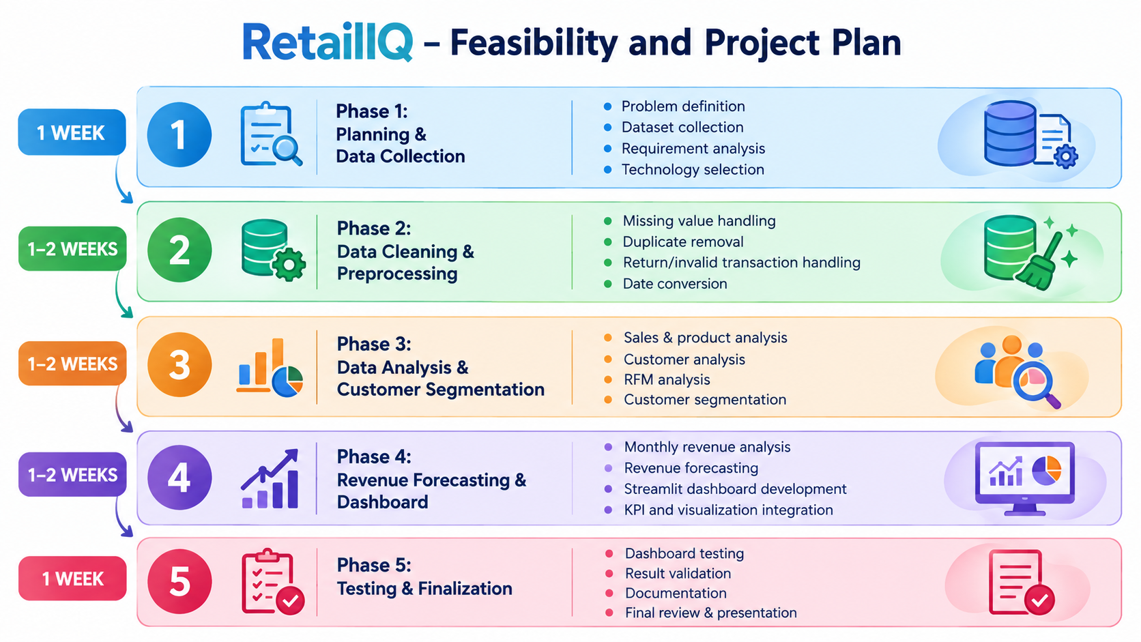
Feasibility and Project Plan

